Slide 1
Suffix Trees
Chinmayi C. Ramakrishna (181IT113)
Mansi Saxena (181IT126)
Meghna Kashyap (181IT127)
K. Keerthana (181IT221)

Slide 2
Introduction
Suffix tree is a compressed trie of all the suffixes of a given string.
A suffix tree is a data structure constructed from a text whose size is a linear function of the length of the text and which can also be constructed in linear time.
It provides for locating interestingly long strings that occur in the text more than a given number of times.

Slide 3
By virtue of this capability, it plays a crucial role in some text compression techniques because it allows repeated sequences of characters to be represented explicitly only once, other instances being replaced by a reference to that instance of the sequence.
Suffix trees can be used to solve a large number of string problems that occur in text-editing, free-text search, data compression, computational biology and other application areas.

Slide 4
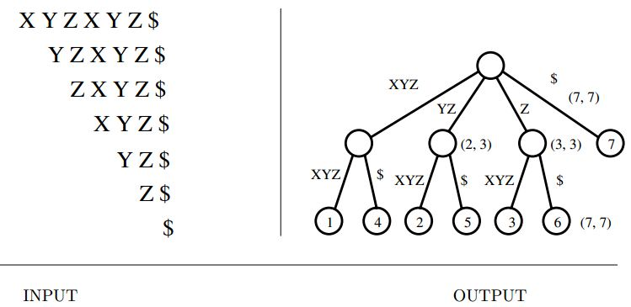
Suffix Tree Example

Slide 5
Ukkonen’s algorithm
Ukkonen's algorithm is a linear-time.
It is an online algorithm for constructing suffix trees.
Online algorithm is one that can process in the order that the input is fed to the algorithm, without having the entire input available from the start.
This algorithm builds a suffix tree for a given string S of length n in O(nlog(k)) time, where k is the size of the alphabet.
This algorithm constructs an implicit suffix tree for every prefix of the string S.

Slide 6
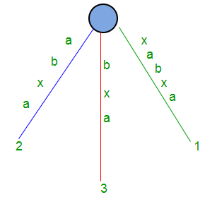
Implicit & Explicit Suffix Tree
Implicit suffix tree is one where all suffixes don’t end in a leaf Explicit suffix tree is one where suffixes end in leaves Ex: implicit Suffix tree: (this can be converted to explicit by adding special char like $)
xabxa$
01234

Slide 7
Objective
Suffix Tree is constructed in linear time using Ukkonen's algorithm. Our objective is to carry out 3 different applications, using the tree, on a dataset of 312 short stories from Aesop's Fables.
These applications are:
Finding all occurrences of a string in the stories
Find the first occurence of a string. If not found, find the first occurence of the longest substring of the string

Slide 8
3. Find and rank all stories for a given string according to certain rules Rules:
If the whole substring is found in a story, score = 150
If all words in the string are found, (need not be consecutive), score = 75
If a substring of string is found:
if len(substring) >= 0.6*len(Query_string), score = 40
Else discard the substring
If some words in the query are found, for each matched word in the query,
if len(word) > 5 score += 10
if len(word) > 2 score += 5
if len(word) < 2 score += 1
If a word with len(word) > 2 has occurred multiple times, score += n * 3, n being the number of times it has occured

Slide 9
Requirement Analysis
Software Requirements :
Ubuntu/Linux/Windows
Python3

Slide 10
Methodology
The algorithm begins with an implicit suffix tree containing the first character of the string. Then it steps through the string adding successive characters until the tree is complete.This order addition of characters gives Ukkonen's algorithm its "on-line" property. This way suffix tree is constructed
There is a function that finds the index of a given substring in all stories.
There is another function that does a DFS traversal from the node at which the substring ends to find all occurrences of a substring in the stories
Using these functions, the 3 usages are implemented.
The input in our project is 312 short stories converted into a dataset. Each story has its own suffix tree object. All 312 objects are stored in an array called ‘fables’. The user can then choose which application they would like to try out (1, 2 or 3)

Slide 11
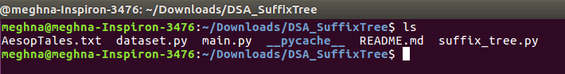
Screenshots
Fig 1. Contents of the folder

Slide 12
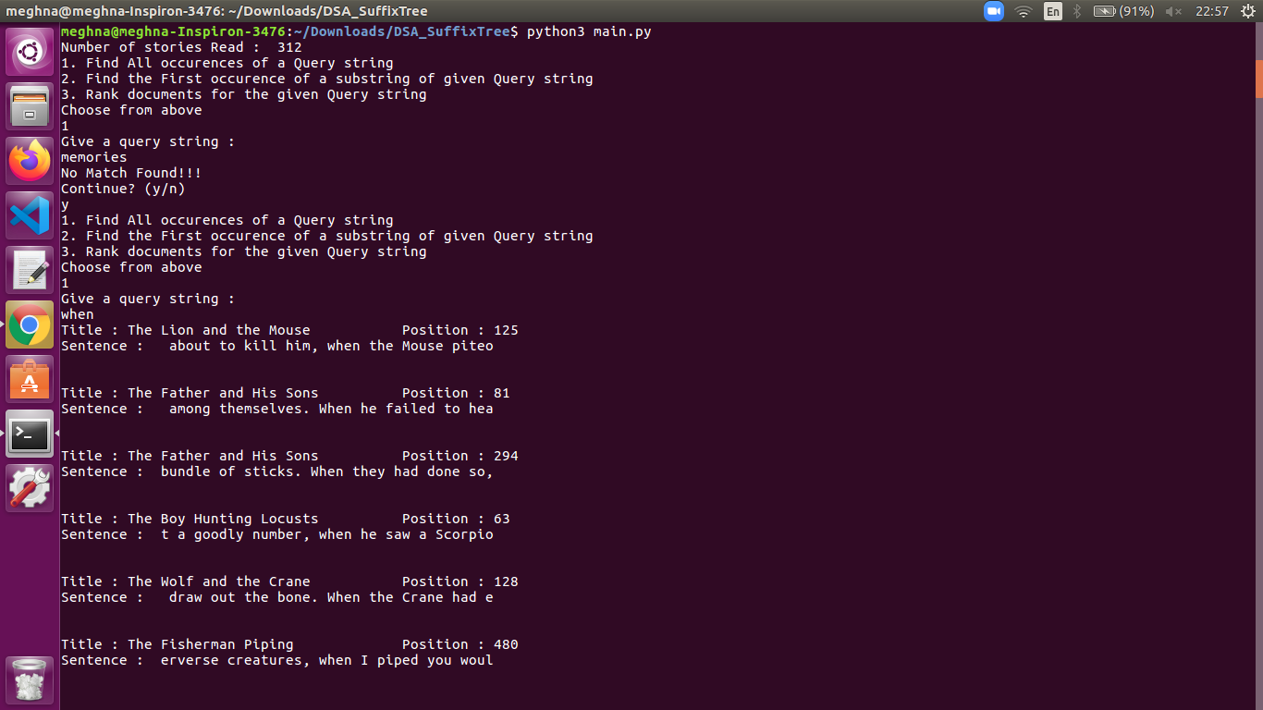
Screenshots
Fig 2. Finding all occurrences of a string in the stories

Slide 13
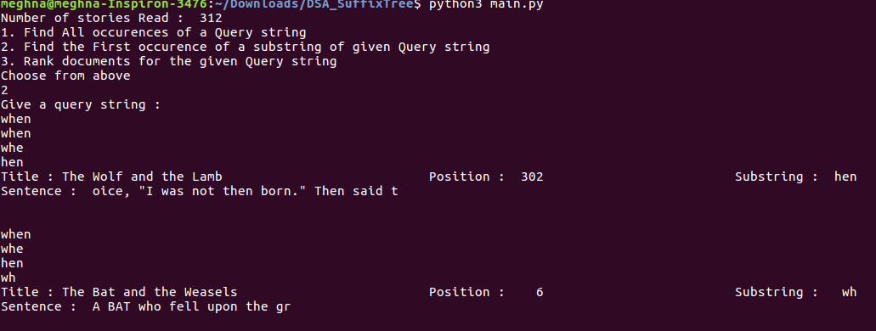
Screenshots
Figure3: Finding the first occurence of a string. If not found, finding the first occurence of the longest substring of the string

Slide 14
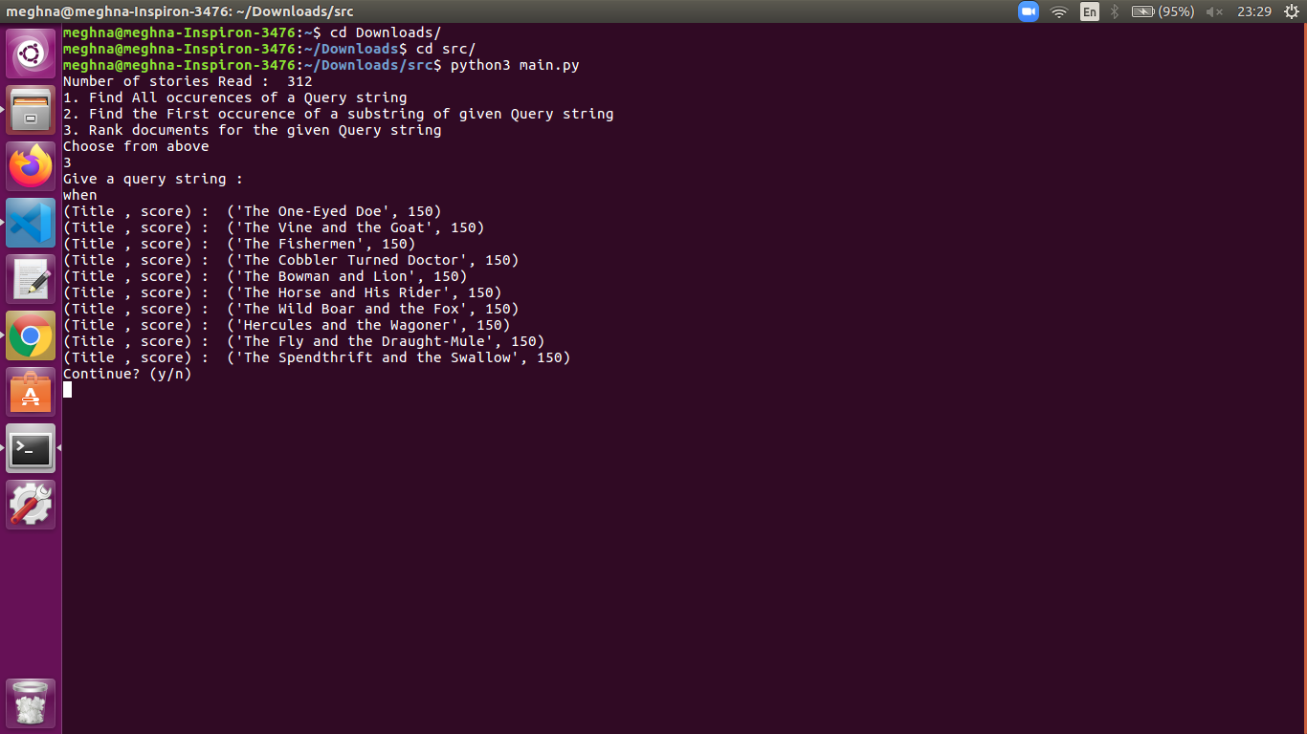
Screenshots
Figure4: Find and rank all stories for a given string according to certain rules

Slide 15
Conclusion
Building a suffix tree through brute force method would take a worst case time complexity of O(n^2)
Hence Ukkonen’s algorithm is used since it reduced it to a linear time complexity.
Time Complexity is O(m). It is a linear time algorithm.

